Slide 1
MACHINE LEARNING
Artificial Intelligence
Machine Learning
Supervised Learning
Unsupervised Learning
ReInforcement Learning
Linear Regression
Classification
Naive Bayes and Decision Trees

Slide 2
What is Artificial Intelligence?
The human intelligence inside the computer is called Artificial Intelligence.
AI systems can be built using various techniques, including machine learning, deep learning, natural language processing, computer vision, and expert systems. Machine learning algorithms enable computers to learn from data and improve their performance over time without being explicitly programmed.

Slide 3
WHAT IS MACHINE LEARNING?
Making the machines to learn is called Machine learning. It is a field of study that explores algorithms and statistical models that allow computers to learn from and analyze large datasets to identify patterns, make predictions, or take actions.
In traditional programming, developers write explicit instructions for a computer to perform a specific task. In machine learning, however, the computer learns from data and experiences to improve its performance on a particular task.

Slide 4
SUPERVISED LEARNING
Learning form someone. Supervised learning is a machine learning approach where an algorithm learns from a labeled dataset to make predictions or decisions. In supervised learning, the algorithm is provided with input features and corresponding target labels, and the goal is to learn a mapping function that can accurately predict the labels for new, unseen inputs.

Slide 5
UNSUPERVISED LEARNING
Learning on our own. Unsupervised learning is a machine learning approach where an algorithm learns from unlabeled data to discover patterns, relationships, or structures within the data. Unlike supervised learning, unsupervised learning does not have access to target labels or explicit feedback during training. Instead, the algorithm aims to find inherent structures or regularities in the data on its own.

Slide 6
REINFORCEMENT LEARNING
Reinforcement learning is all about making decisions sequentially. In simple words, we can say that the output depends on the state of the current input and the next input depends on the output of the previous input.

Slide 7
LINEAR REGRESSION
Linear regression is a supervised machine learning method that is used by the Train Using AutoML tool and finds a linear equation that best describes the correlation of the explanatory variables with the dependent variable.
Linear regression is a statistical modeling technique used to establish a relationship between a dependent variable and one or more independent variables. It assumes a linear relationship between the variables, where the dependent variable is predicted as a linear combination of the independent variables.

Slide 8
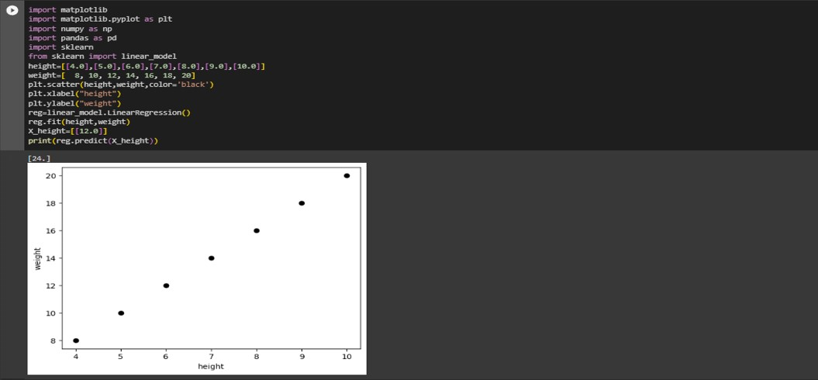
LINEAR REGRESSION CODE

Slide 9
NAÏVE BAYES
Naive Bayes is a probabilistic classification algorithm based on Bayes' theorem with an assumption of independence between features. It is a simple yet effective algorithm that is particularly useful for text classification tasks, such as spam detection or sentiment analysis.

Slide 10
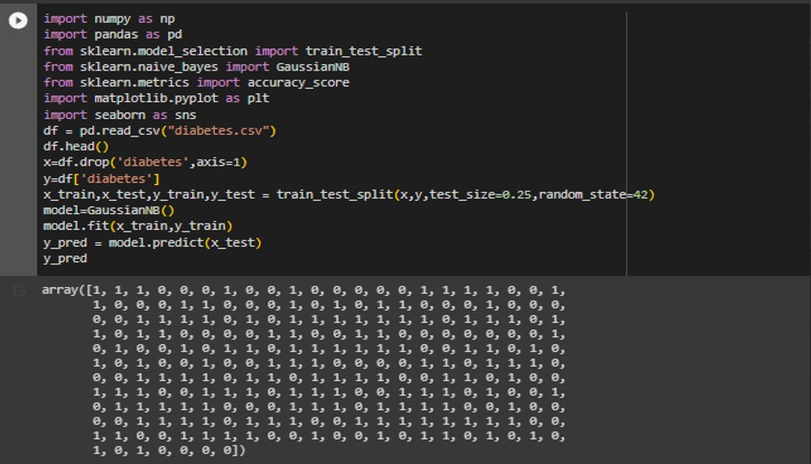
NAÏVE BAYES CODE

Slide 11
DECISCION TREE
A decision tree is a flowchart-like structure that represents a series of decisions and their potential consequences or outcomes. It is a supervised machine learning algorithm that can be used for both classification and regression tasks.
In a decision tree, each internal node represents a feature or attribute, and each branch represents a decision or outcome based on that feature. The leaves of the tree represent the final decision or outcome.

Slide 12
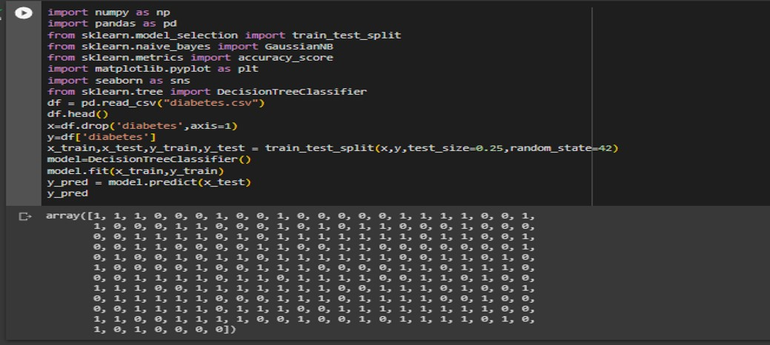
DECISCION TREE CODE

Slide 13
RANDOM FOREST
Random Forest is an ensemble machine learning algorithm that combines the predictions of multiple individual decision trees to make more accurate and robust predictions. It is a popular and powerful algorithm that can be used for both classification and regression tasks.
The random forest algorithm creates an ensemble of decision trees by randomly selecting a subset of features and a subset of the training data for each tree

Slide 14
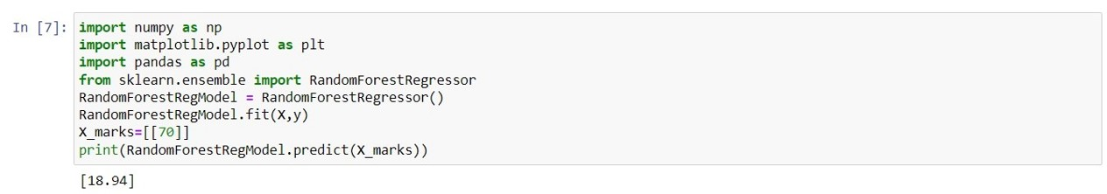
RANDOM FOREST CODE

Slide 15
SVM(SUPPORT VECTOR MACHINES)
Support Vector Machines (SVM) is a supervised machine learning algorithm used for both classification and regression tasks. SVMs are particularly effective in solving complex problems with high-dimensional feature spaces.
The main objective of an SVM is to find an optimal hyperplane that separates the data points of different classes with the maximum margin. In the case of classification, the hyperplane acts as a decision boundary that separates the data into distinct classes. SVM can handle both linearly separable data, where a straight line can separate the classes, and non-linearly separable data, where it uses a technique called the kernel trick.

Slide 16
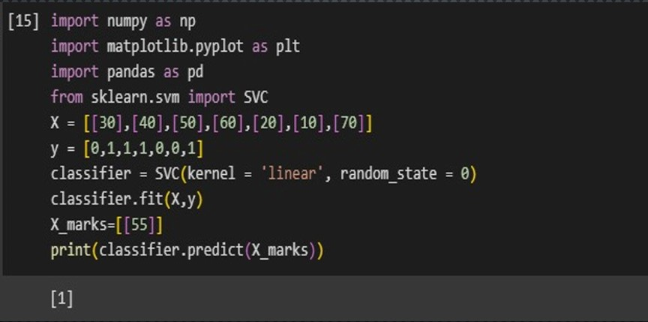
SVM CODE

Slide 17
KNN(K-NEAREST NEIGHBORS)
K-Nearest Neighbors (KNN) is a supervised machine learning algorithm used for classification and regression tasks. It is a non-parametric algorithm, meaning it does not make any assumptions about the underlying distribution of the data.
KNN works based on the principle that similar data points tend to belong to the same class or have similar target values. It classifies or predicts the label of a new instance by comparing it to the k nearest neighbors in the training dataset. The value of k is a hyperparameter that needs to be set before training the model.

Slide 18
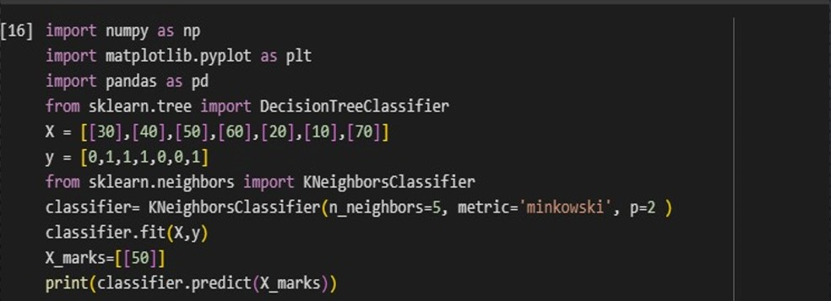
KNN CODE

